Slide 1


Food adulteration acts PART II
Mary Anupama Palukurty
Assistant Professor,
Dept. of Biochemistry,
St.Joseph’s College for Women (A),
Visakhapatnam

Slide 2
SUBCOMMITTES UNDER FOOD AND HEALTH AUTHORITY Ltd
There are 9 sub-committees functioning at present: The details of such committees are given as under :
1. Sub- Committee on Food Laws and Legal advisory Committee
2. Sub - Committee on Food Labelling
3. Sub- Committee on Food Additives & Contaminants
4. Sub- Committee on Milk and Milk Products
5. Sub- Committee on Microbiological
6. Sub- Committee on Oil and Fats
7. Sub- Committee on Pesticide Residues
8. Sub- Committee on Nutrition Food for Special Dietary Uses for Infant, and
9. Sub- Committee on Methods of Analysis

Slide 3
CENTRAL FOOD LABORATORIES
Section 4: This section provides for the establishment of Central Food Laboratories (CFL)
At present there are four such labs: one each at (i) Kolkata &
(ii) Ghaziabad (under Central Government),
(iii) Public Health (PH), LAB, Pune and
(iv) Central Food Technological Research Institute (CFTRI), Mysore, notified as CFL for the purposes of the Act.

Slide 4
CFL’s are the appellate laboratories for the following purposes:-
(i) for the analysis of samples received from courts under section 13 (2) (b) and issue certificates of analysis which supersedes the report of Public Analysts [(Section 13 (3)]. The jurisdiction of these labs for various areas are specified in table (1) of Rule 3 (2) of PFA Rules.
(ii) for the analysis of import products sent by the customs (Section 6) (2)]. The areas in respect of local areas assigned to various labs are provided in Table II of rule 3 (2) of PFA Rules.
(iii) for any other matter as considered necessary by Central Government [Section 4 (2)].

Slide 5
Section 5: Provides for prohibition of imports which are in contravention of law.
Section 6: Provides powers to Custom officers to detain imported foods prohibited under the law, and send samples to Central Food Laboratory.
Section 7: This section prohibits the manufacture, sale or storage of adulterated foods.
Section 8 (Analysis of Foods): This section empowers the Central Government/ State Governments to appoint Public Analyst having prescribed qualifications
The primary task of public analyst is to analyse the samples sent by the food inspectors, consumer organizations or others.

Slide 6
Section9: Role of Food Inspectors
It confers powers upon to the Central/ State Governments to appoint food inspectors
The primary responsibility of food inspector is to draw the samples from the manufacturer’s premises/ markets or other places under their jurisdiction as provided in the State rules for analysis by the Public Analyst.
The Food Inspector, have powers to prohibit the sale of an article of food, if it appears to be adulterated and to seize and carry away the seized stock or keep it in the custody and send part of the sample for analysis by the public analysists.
Food Inspector may seize the books of accounts which are useful and relevant for any investigation with the approval of his immediate officer.

Slide 7
Section 11 Procedure to be followed by Food Inspector
This section provides the procedure to be followed by the Food Inspector for drawing samples.
The procedure to be followed are as under :
a) Give notice in writing to the person from whom he has taken the sample
b) Divide the sample into three parts and mark and seal or fasten up each part
c) If the person refuses to sign or put his thumb impression on sample, the Food Inspector shall call upon witnesses to sign samples
send one part of the sample to the public analyst
send remaining two parts to the local (Health) authority for further legal action.
d) Food seized shall be produced before Magistrate as soon as possible, (within 7 days)

Slide 8
Section 12 (Power of Purchaser)
This section allows a purchaser or a recognized consumer organization to get the sample analysed by a Public Analyst on payment of fee and to receive the report of the analysis. The fee as prescribed by the State Government is refunded if the sample is adulterated.
Section 13 Report of Analyst: Public Analyst has to send report to Local Health Authority, who shall forward a copy of the report to the vendor and to the manufacturers/ distributors/ dealer who has supplied sample.
Section 14 (Issue of Warranty)
This section provides that a manufacturer, distributor or dealer has to give a warranty in writing to the vendor, which stands as a defence to vendor in case the same is declared adulterated.A cash memo/ bill is considered as a warranty

Slide 9
Section 15 Report of Food Poisoning
As per this section, the Central/ State governments may require medical practitioners to report cases of food poisoning in their areas of jurisdiction.
The section 16 deals with the Penalties as detailed below:
(next 2 slides)

Slide 10
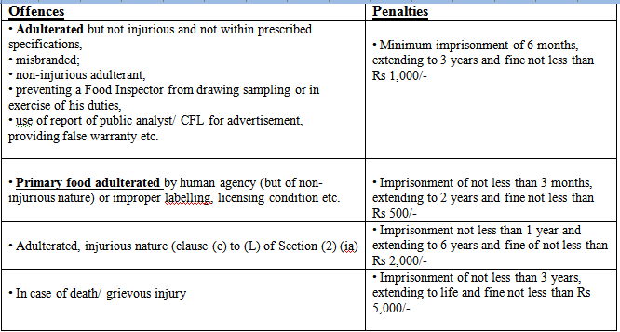

Slide 11
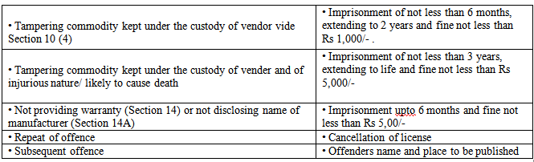

Slide 12
Section 16A: Summary Trials: This section provides summary trials by Judicial Magistrates of 1st class or Metropolitan Magistrate who can pass maximum imprisonment of 1 year.
Section 17: Nomination by Company: As per this section, the companies can nominate a person responsible for the business of the company and inform Local Health Authority of such nominations with the written consent of the nominee.
Section 18: Forfeiture: As per this section the articles of food, contravening the law, can be forfeited by the concerned authorities.
Section 19: A warranty under section 14 from a licensed vendor stands as a defense in as a case of prosecution, as per section 19.

Slide 13
Section 20: Cognizance of offence: This section stipulates that a prosecution can be launched with the written consent of a person authorized by Central/ State Government except in case of warranty. A purchaser can directly make a complaint to the court with a copy of the report of Public Analyst.
Section 20A: Impleading Manufacturer: As per section 20 A, a manufacturer, distributor or dealer can be impleaded on the evidence adduced before the court if such person is also connected with the commission of the offence .
Section 21: Power of Magistrate : The section 21 clearly stipulates that only the 1st class Magistrate or Metropolitan Magistrate can pass any sentence under this Act except life imprisonment or more than 6 years imprisonment.
Section 22: Protection to Government Officers if action is taken in good faith: As per this section, legal proceedings cant not be initiated against government officers , if the action is taken in food faith

Slide 14
Section 23: Powers of Central Government to make rules:
1. Defining standards of quality : The Rules (Appendix B ) provide in detail the Standards of a product in relation to quality parameters like fat content in different classes of milk or milk products, ingredients to be used in different categories of food e.g. use of additives like colours, preservatives, antioxidants, artificial sweeteners etc and their maximum levels of use, the requirements of nutrients in certain food viz Infant food, infant milk substitutes characteristics to detect adulteration, minimum juice content in fruit drinks etc.

Slide 15
Section 24: Powers of State Governments: This section empowers the state governments to frame rules and regulations after consultation with CCFS and previous publications, for the following purposes:
1. Defining powers, jurisdictions and duties of Food (Health) Authority and Local (Health)Authority.
2. Form, fees and conditions for licenses for manufacture, storage, sale, and distribution of articles of food.
3. Fees for analysis, apportionment (distribution) of fines between local authorities and others.
4. Delegation of powers to subordinate authorities by food (Health) Authority.
5. Rules made by State Government to be laid before state legislatures.
Section 25: As per section 25, all corresponding laws/ Acts in force in states/ union territories stand repealed

Slide 16
Thank you

